Slide 1
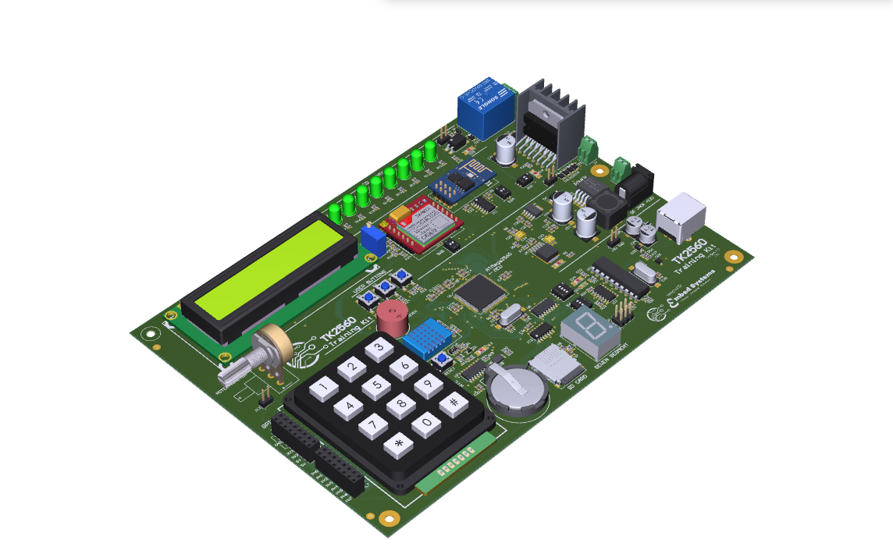
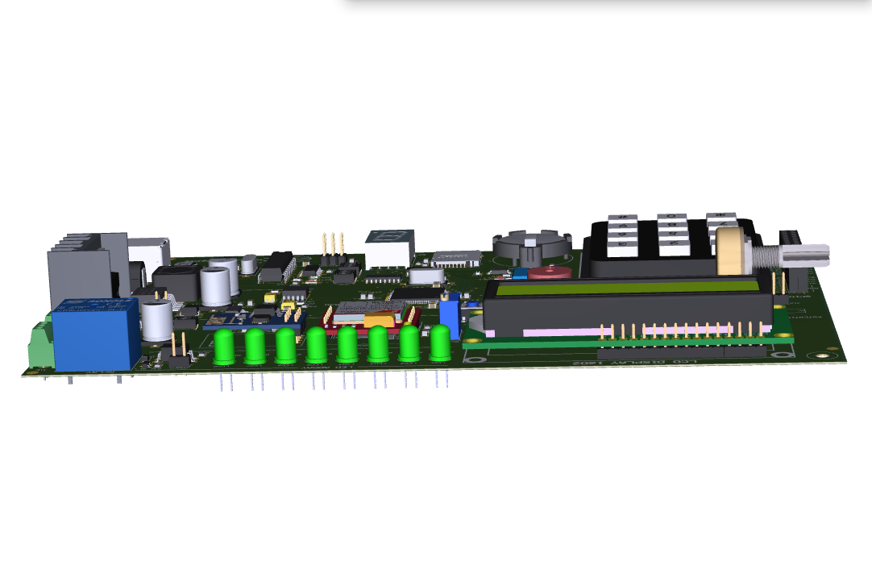
TK2560 FEATURES
ATMega2560 MCU
Realtime Clock (DS3231) with backup battery
16x2 LCD Display
EEPROM
1 Digit Seven Segment
WIFI (ESP8166)
8 LEDs Array
GSM (SIM800L)
Buzzer
Micro SD Card Slot
Opto-coupled Solenoid relay
Motor Driver (L298N)
4x3 Keypad
Onboard ISP (USBTiny)
3 User Buttons
24 GPIOs
DHT11 Temp. sensor
Analog in; Potentiometer

Slide 2
TK2560 FEATURES
ATMega2560 MCU
Realtime Clock (DS3231) with backup battery
16x2 LCD Display
EEPROM
1 Digit Seven Segment
WIFI (ESP8166)
8 LEDs Array
GSM (SIM800L)
Buzzer
Micro SD Card Slot
Opto-coupled Solenoid relay
Motor Driver (L298N)
4x3 Keypad
Onboard ISP (USBTiny)
3 User Buttons
24 GPIOs
DHT11 Temp. sensor
Analog in; Potentiometer

Slide 3
Opto-coupled Solenoid relay
Motor Driver (L298N)
WIFI (ESP8166)
GSM (SIM800L)
Power: 5-12V
8 LEDs Array
16x2 LCD Display
Onboard ISP (USBTiny)
3 User Buttons
ATMega2560 MCU
Buzzer
1 Digit Seven Segment
Analog in; Potentiometer
Micro SD Card Slot
Realtime Clock (DS3231) with backup battery
24 GPIOs
DHT11 Temp. sensor
4x3 Keypad

Slide 4
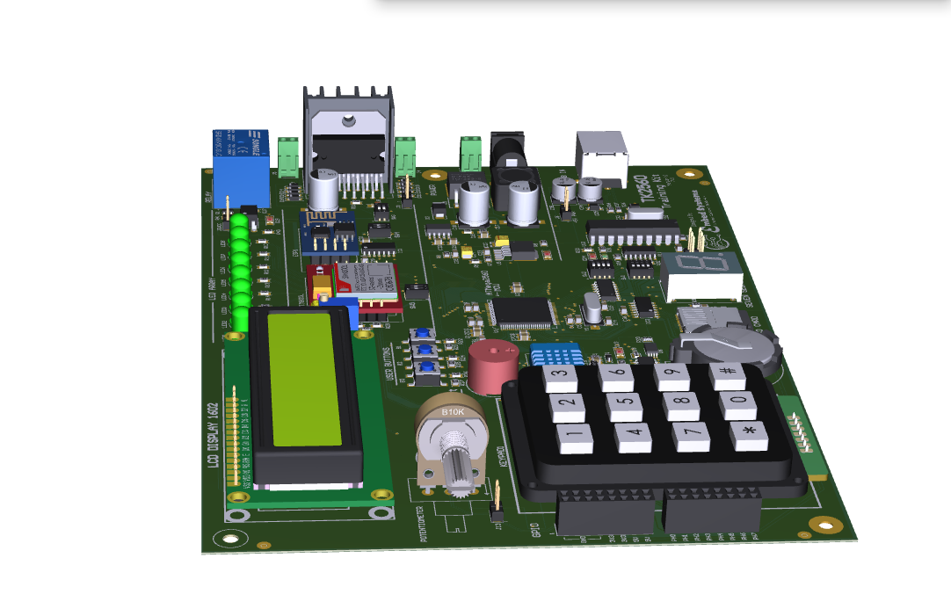

Slide 5
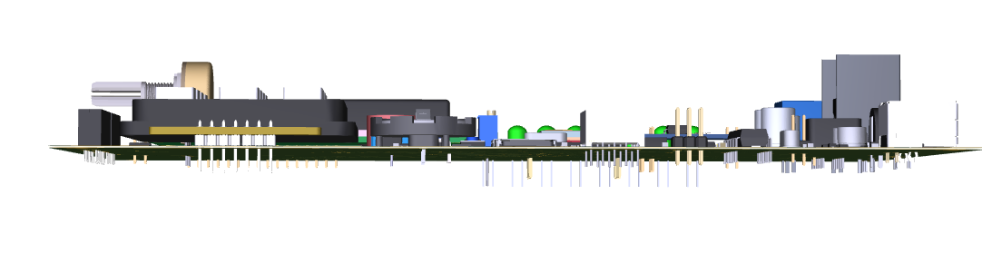

Slide 6
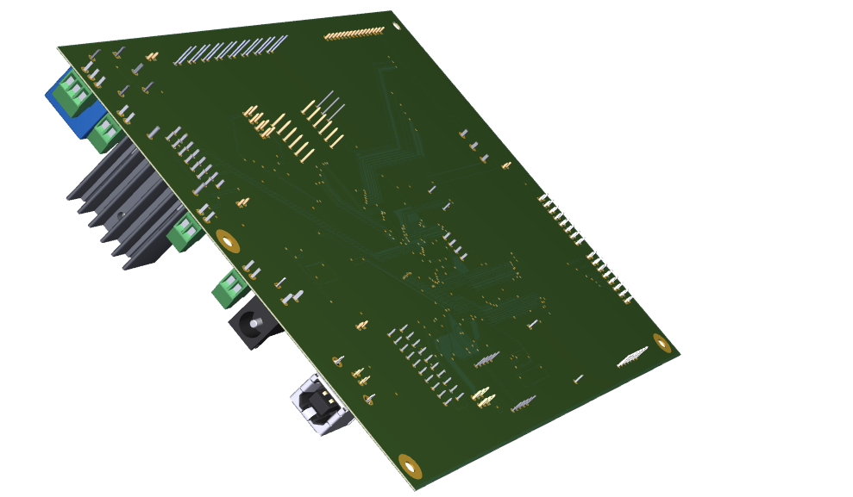
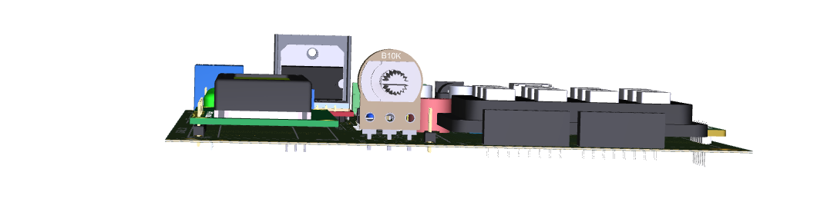

Slide 7
TK2560 FEATURES
ATMega2560 MCU
Realtime Clock (DS3231) with backup battery
16x2 LCD Display
EEPROM
1 Digit Seven Segment
WIFI (ESP8166)
8 LEDs Array
GSM (SIM800L)
Buzzer
Micro SD Card Slot
Opto-coupled Solenoid relay
Motor Driver (L298N)
4x3 Keypad
Onboard ISP (USBTiny)
3 User Buttons
24 GPIOs
DHT11 Temp. sensor
Analog in; Potentiometer

